Slide 1
pose Estimation
Presented By :
2010030007 – Alluri Yashwanth
2010030481 – Manne Tejaswini Sai Gayathri
2010030521 – Konyala Eshika Sanjana
2010030532 – Komaravelli Sai kamal

Slide 2
TABLE OF CONTENTS
01.
02.
03.
Introduction
PROBLEM STATEMENT
Flow diagram
05.
06.
07.
Pre-processing Code
IMPLEMENTATION
04.
LITERATURE SURVEY
08.
DATASET
CONCLUSION

Slide 3
INTRODUCTION
Position estimation is a technique used in computer vision to track a person or object's movements. Usually, this is done by locating key points for the given objects. Through the comparison of these key points, we can develop insights into diverse movements and postures. Position estimation plays a critical role in augmented reality, animation, games, and robotic.

Slide 4
PROBLEM STATEMENT
The general task of recognizing human activity is very broad. For that reason, the field has been conceptually divided, and depending on the complexity of the activity we typically talk about action primitives, actions, activities, interactions, and group activities.

Slide 5

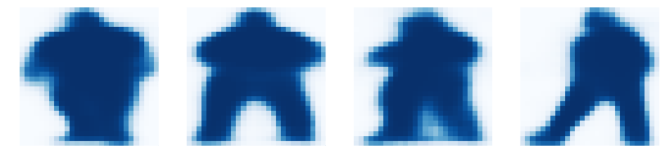


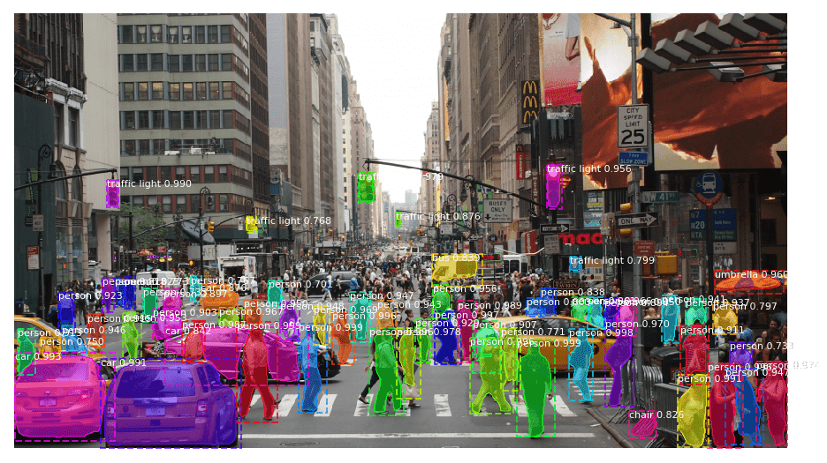


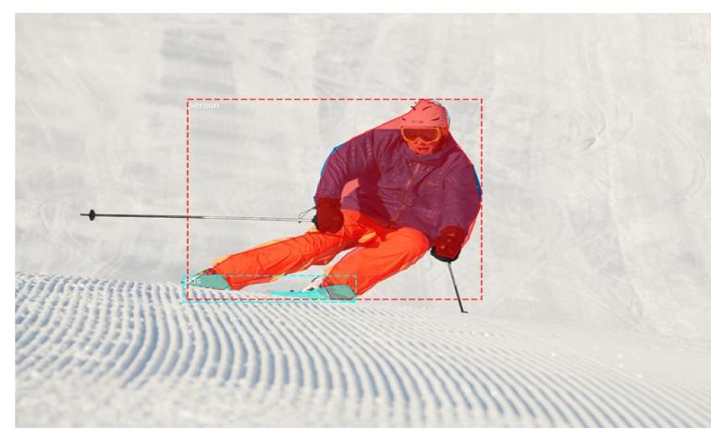
FLOW CHART
DATASET
DATASET PRE-PROCESSING
MODEL
MODEL EVALUTION
PROTOTYPE

Slide 6
MOTIVATION
Computer vision is an interdisciplinary scientific field that deals with how computers can gain high-level understanding from digital images or videos. This we found something very much interstellar to us. So we checked out different projects we can work under this and we decided to do multi-pose estimation as we wanted to know how computers are able to identify poses when given images and videos.

Slide 7
LITERATURE SURVEY

Slide 8
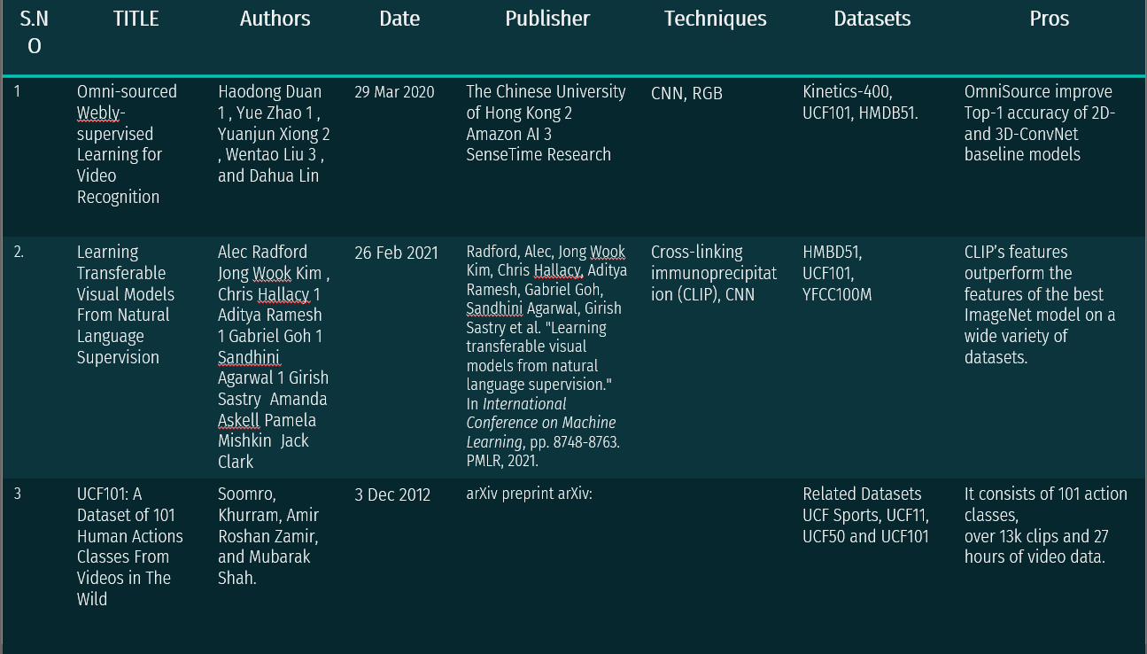

Slide 9
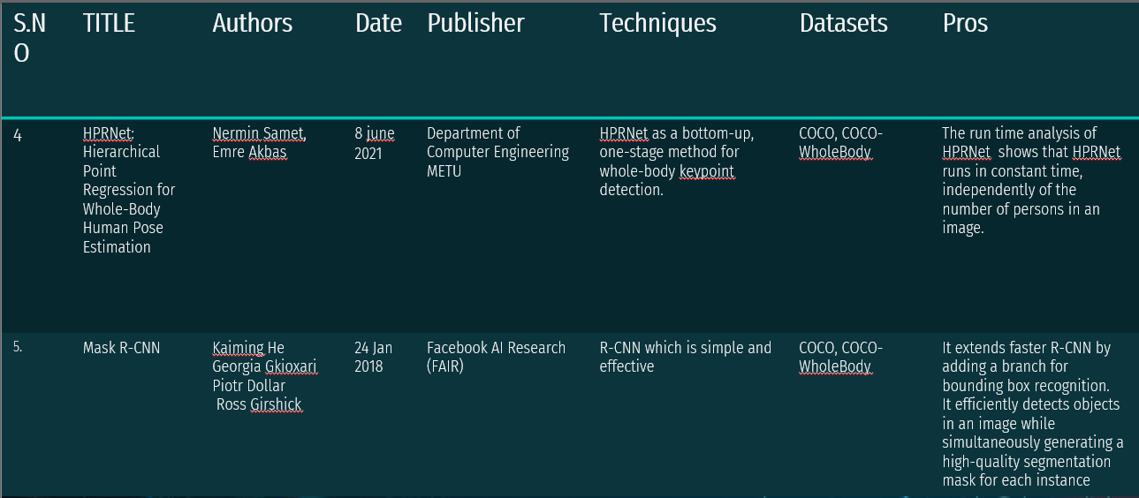

Slide 10
DATASET
UCF101 DATASET:
UCF101 is an action recognition data set of realistic action videos, collected from YouTube, having 101 action categories. This data set is an extension of UCF50 data set which has 50 action categories. With 13320 videos from 101 action categories, UCF101 gives the largest diversity in terms of actions and with the presence of large variations in camera motion, object appearance and pose, object scale, viewpoint, cluttered background, illumination conditions, etc, it is the most challenging data set to date. As most of the available action recognition data sets are not realistic and are staged by actors, UCF101 aims to encourage further research into action recognition by learning and exploring new realistic action categories. The videos in 101 action categories are grouped into 25 groups, where each group can consist of 4-7 videos of an action. The videos from the same group may share some common features, such as similar background, similar viewpoints, etc. The action categories can be divided into five types: 1)Human-Object Interaction 2) Body-Motion Only 3) Human-Human Interaction 4) Playing Musical Instruments 5) Sports.

Slide 11
DATASET
Pre-PROCESSING

Slide 12
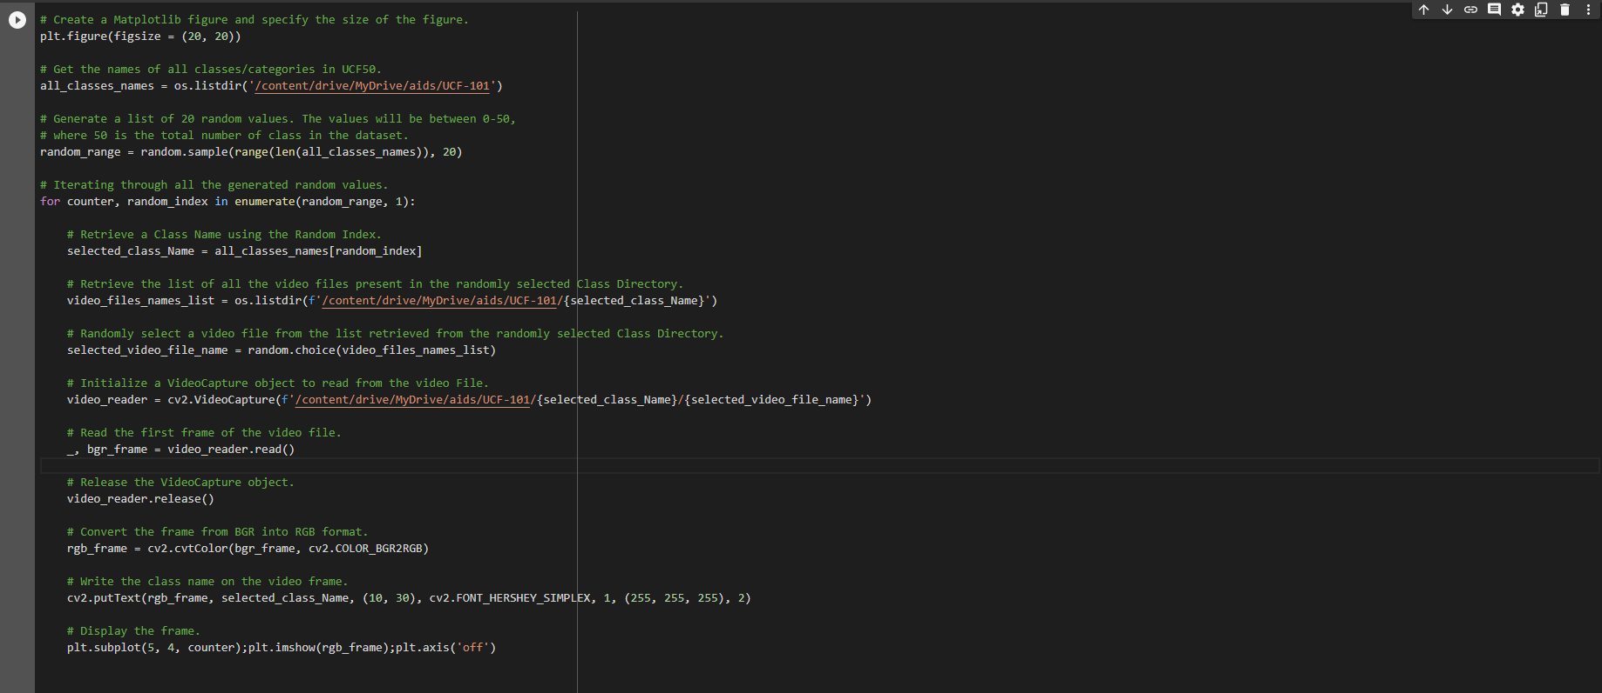

Slide 13
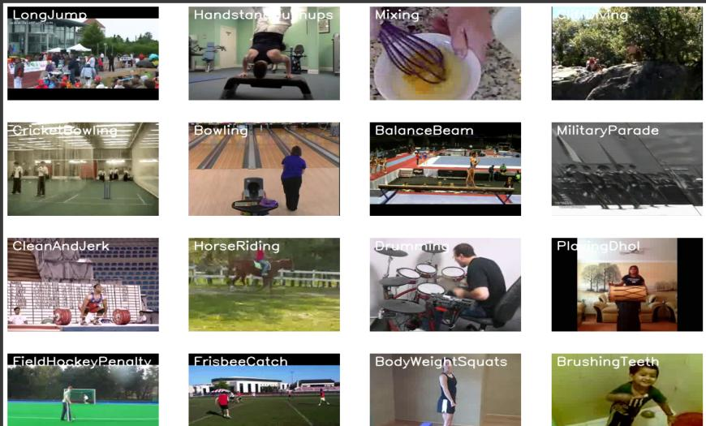

Slide 14
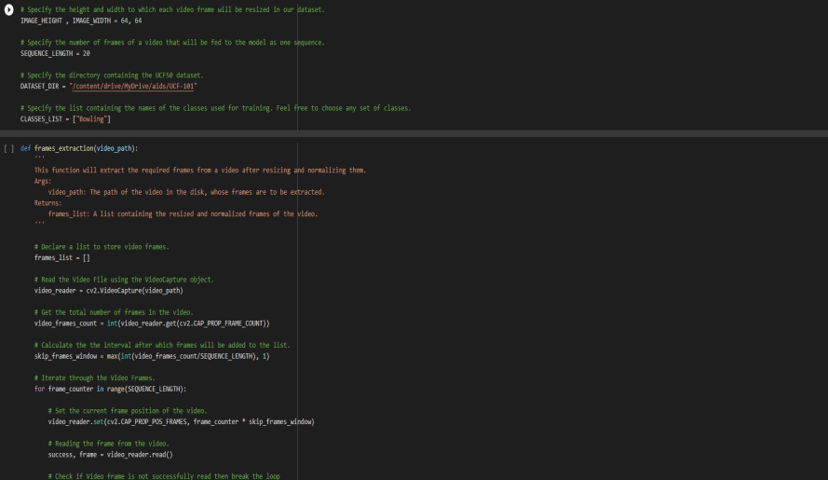

Slide 15
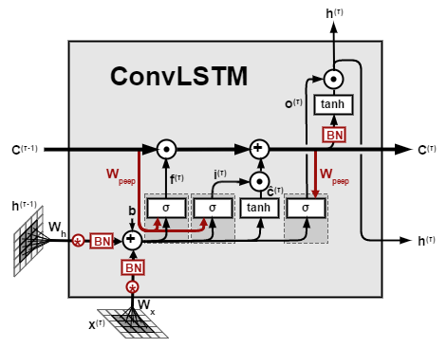
MODEL Convlstm+lrcn
ConvLSTM is a type of recurrent neural network for spatio - temporal prediction that has convolutional structures in both the input-to-state and state-to-state transitions. The ConvLSTM determines the future state of a certain cell in the grid by the inputs and past states of its local neighbors.

Slide 16
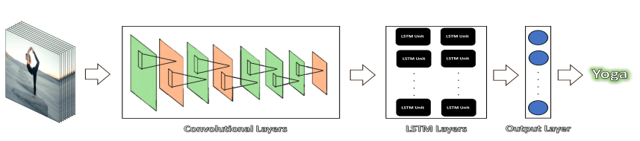
lRCN
The Long-term Recurrent Convolutional Network (LRCN) is proposed by Jeff Donahue et al. in 2016. It is a combination of CNN and RNN, end-to-end trainable and suitable for large-scale visual understanding tasks such as video description, activity recognition and image captioning. The recurrent convolutional models are deeper in that they learn compositional representations in space and time, when the previous models assumed a fixed visual representation or perform simple temporal averaging for sequential processing. And it can be trained or learn temporal dynamics and convolutional perceptual representations as it is directly connected to convolutional network.

Slide 17
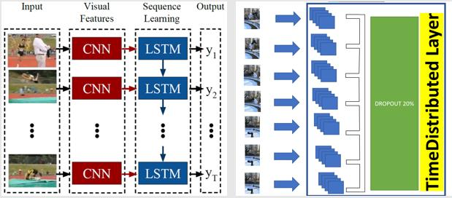

Slide 18
import coco
config = coco.CocoConfig()
COCO_DIR = r"C:\Users\sai kamal\AppData\Local\Programs\Python\Python310\Lib\site-packages\pycocotools\coco" # TODO: enter value here
# Load dataset
if config.NAME == 'shapes':
dataset = shapes.ShapesDataset()
dataset.load_shapes(500, config.IMAGE_SHAPE[0], config.IMAGE_SHAPE[1])
elif config.NAME == "coco":
dataset = coco.CocoDataset()
dataset.load_coco(COCO_DIR,"train")
# Must call before using the dataset
dataset.prepare()
print("Image Count: {}".format(len(dataset.image_ids)))
print("Class Count: {}".format(dataset.num_classes))
for i, info in enumerate(dataset.class_info):
print("{:3}. {:50}".format(i, info['name']))
CODE

Slide 19
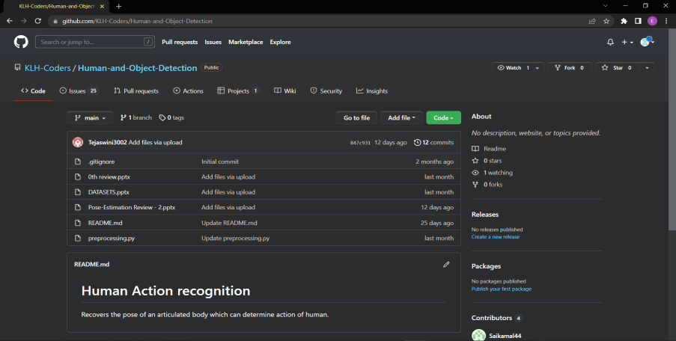
GITHUB COMMITS

Slide 20
IMPLEMENTATION

Slide 21
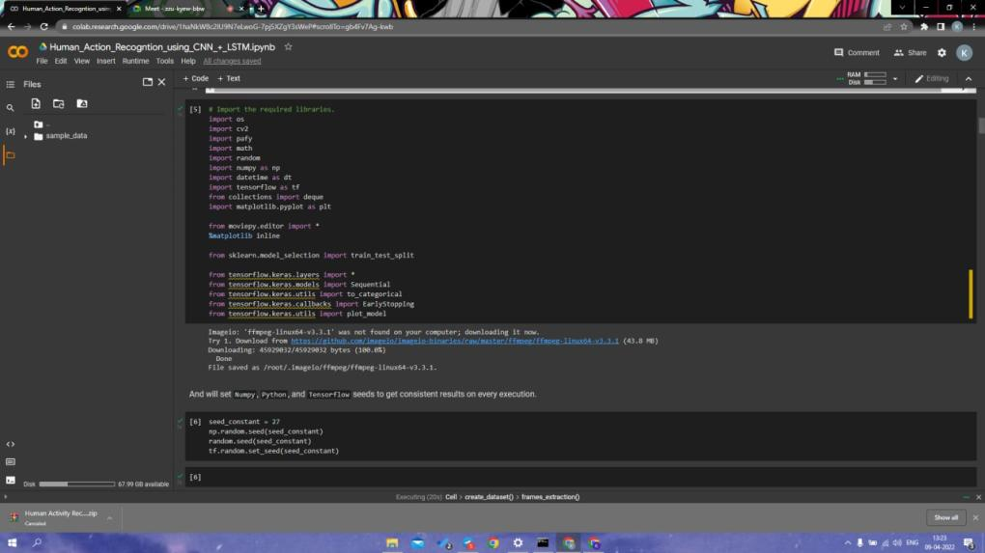

Slide 22
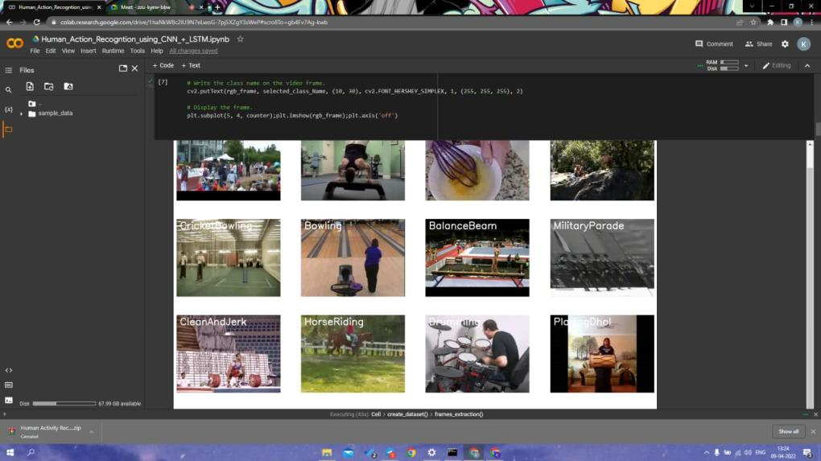

Slide 23
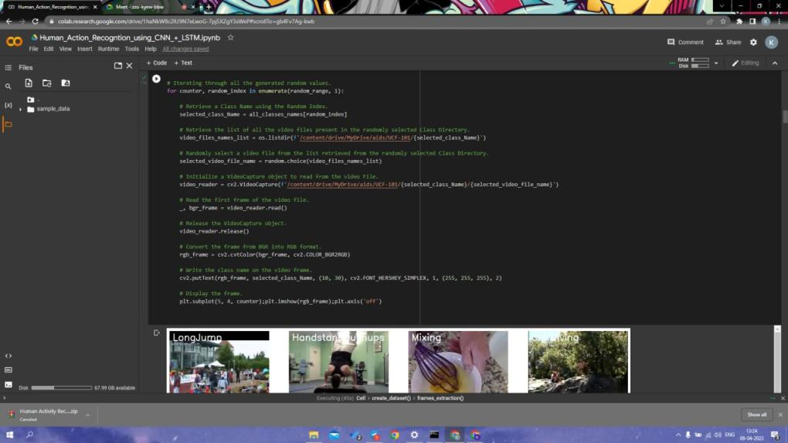

Slide 24
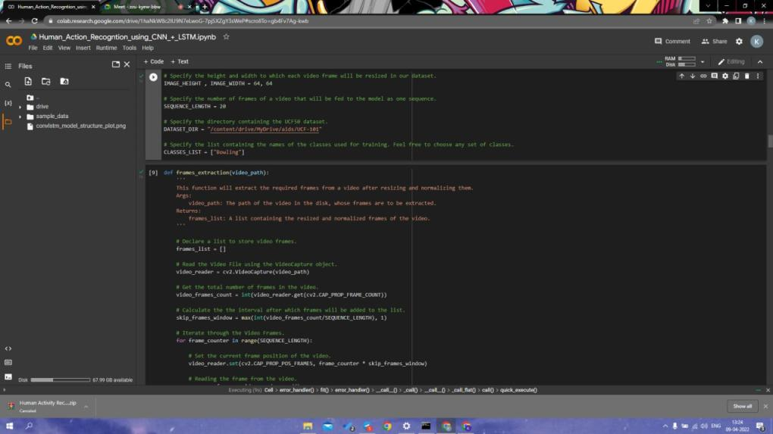

Slide 25
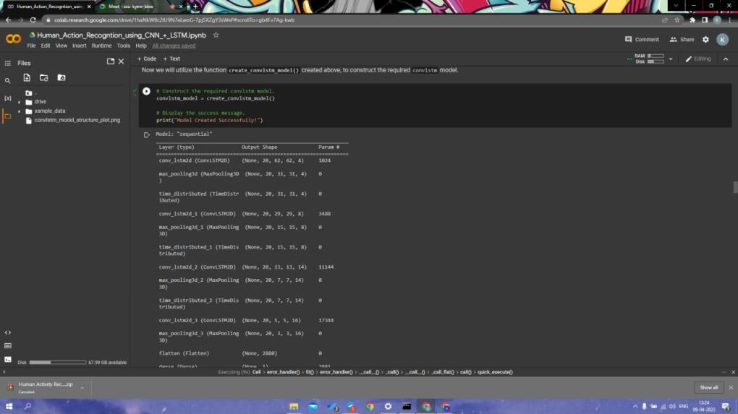

Slide 26
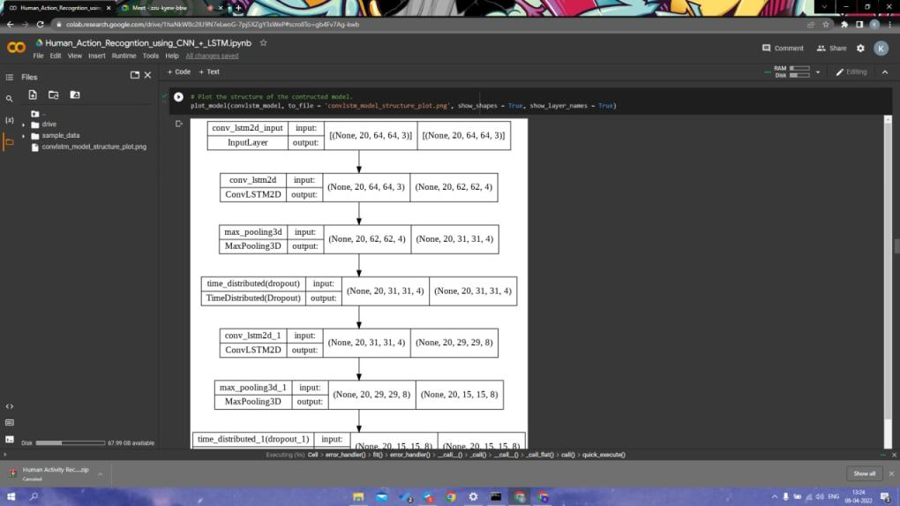

Slide 27
Conclusion
I model actions as sequences of tentatively identified poses, and I think of pose sequences as having a story-like quality, with one such sequence telling a walking story and another, a jumping story. This point of view encouraged an unusual emphasis on single-frame processing in my work and provides a foundation for dealing with more complex actions and actions achieved in multiple ways, such as drinking, in future work.

Slide 28


